Slide 1
ME16A: CHAPTER SIX
TORSION OF CIRCULAR CROSS-SECTIONS

Slide 2
6.1. SIMPLE TORSION THEORY
When a uniform circular shaft is subjected to a torque, it can be shown that every section of the shaft is subjected to a state of pure shear (Fig. 6.1), the moment of resistance developed by the shear stresses being everywhere equal to the magnitude, and opposite in sense, to the applied torque.
For the purposes of deriving a simple theory to describe the behaviour of shafts subjected to torque it is necessary to make the following basic assumptions:

Slide 3
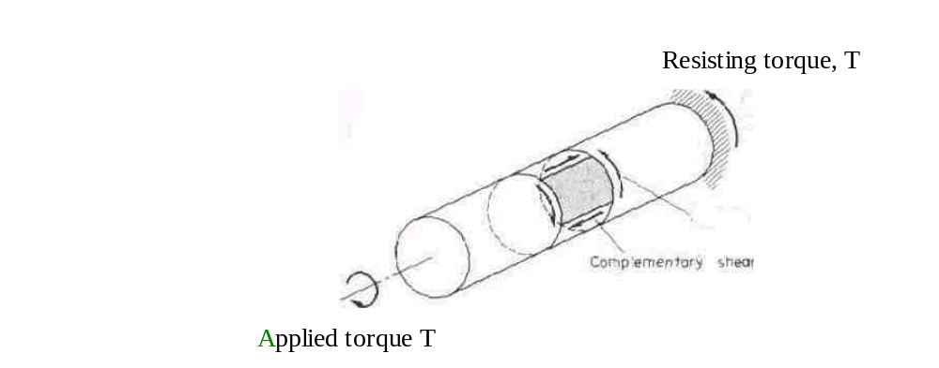
Shear System Set Up on an Element in the Surface of a Shaft Subjected to Torsion

Slide 4
Assumptions
(1) The material is homogeneous, i.e. of uniform elastic properties throughout.
(2) The material is elastic, following Hooke's law with shear stress proportional to shear
strain.
(3) The stress does not exceed the elastic limit or limit of proportionality.
(4) Circular sections remain circular.

Slide 5
Assumptions Contd.
(5) Cross-sections remain plane. (This is certainly not the case with the torsion of non-circular sections.)
(6) Cross-sections rotate as if rigid, i.e. every diameter rotates through the same angle.
Practical tests carried out on circular shafts have shown that the theory developed below on the basis of these assumptions shows excellent correlation with experimental results.

Slide 6
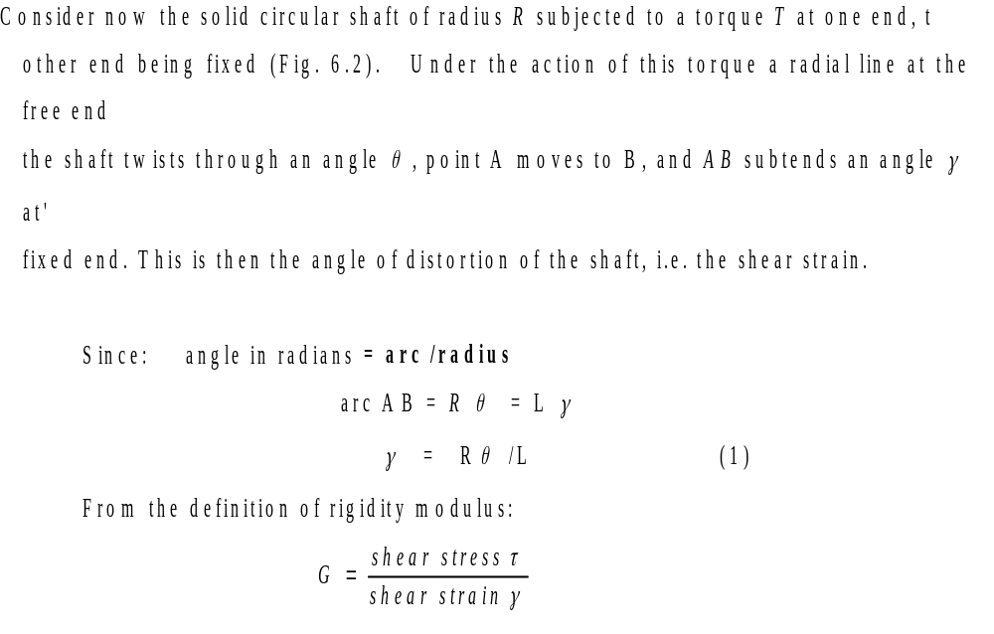
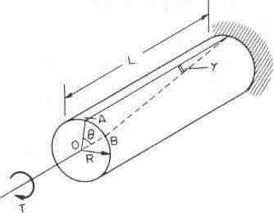
(a) Angle of Twist

Slide 7
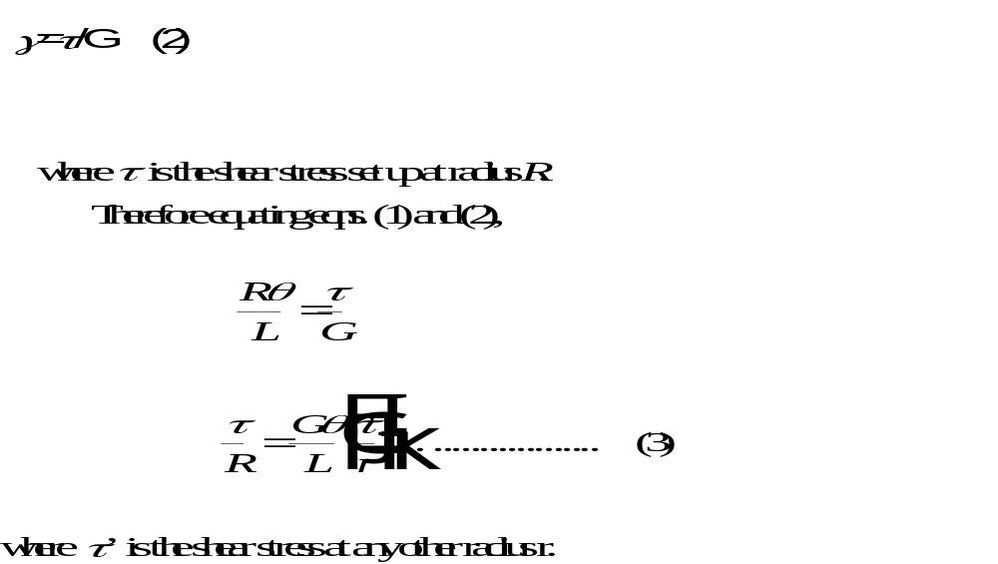
Simple Torsion Theory Contd.

Slide 8
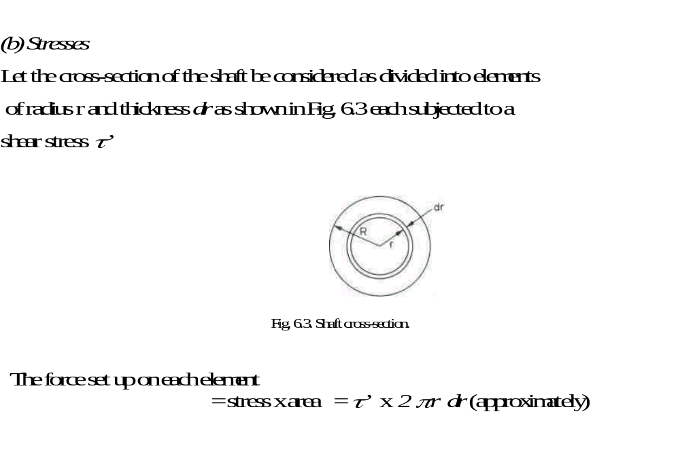

Slide 9
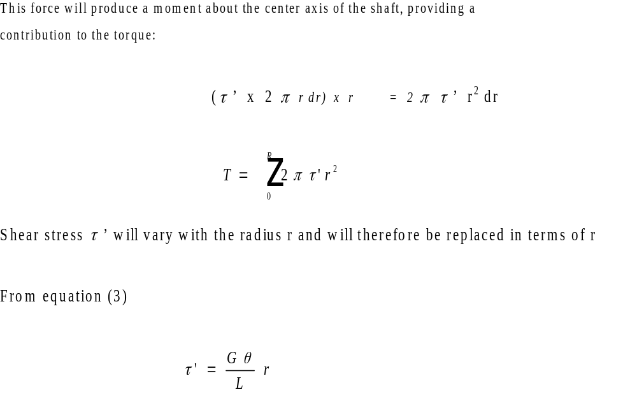

Slide 10
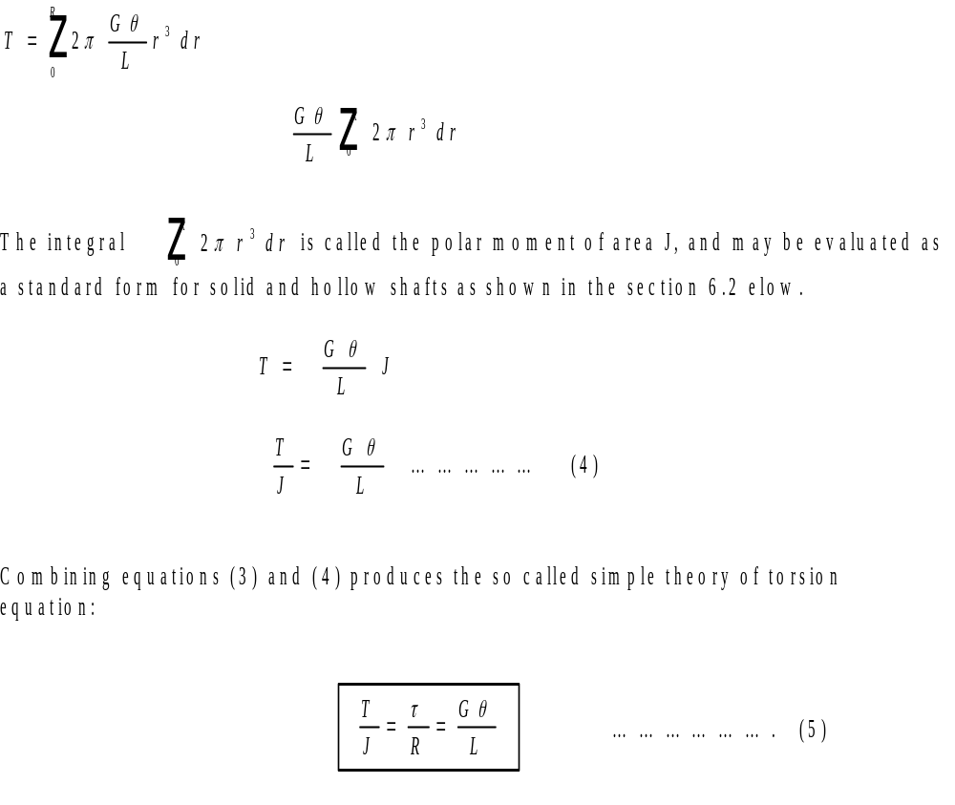

Slide 11
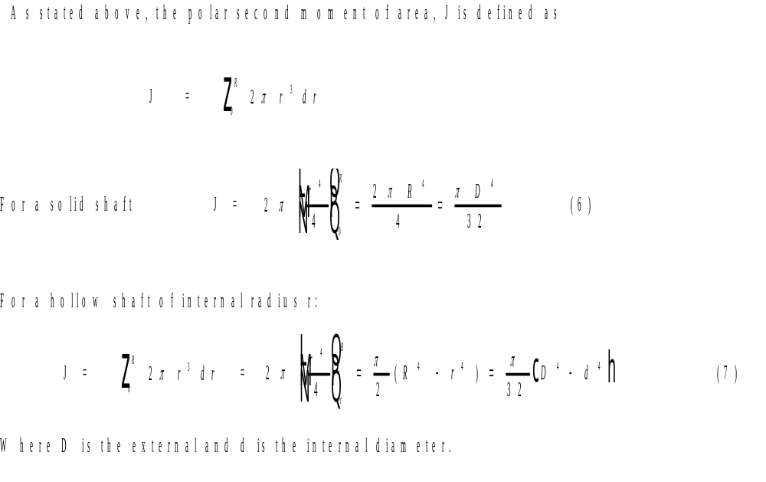
6.2 POLAR SECOND MOMENT OF AREA

Slide 12
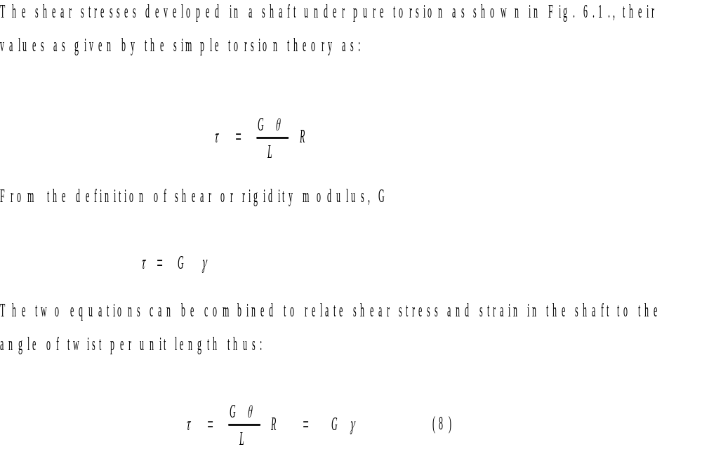
6.3 Shear Stress and Shear Strain in Shafts

Slide 13
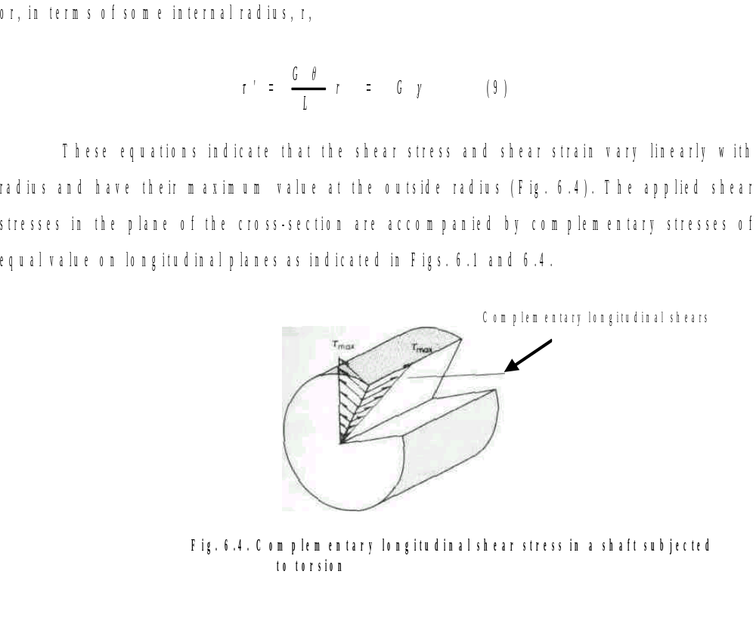

Slide 14
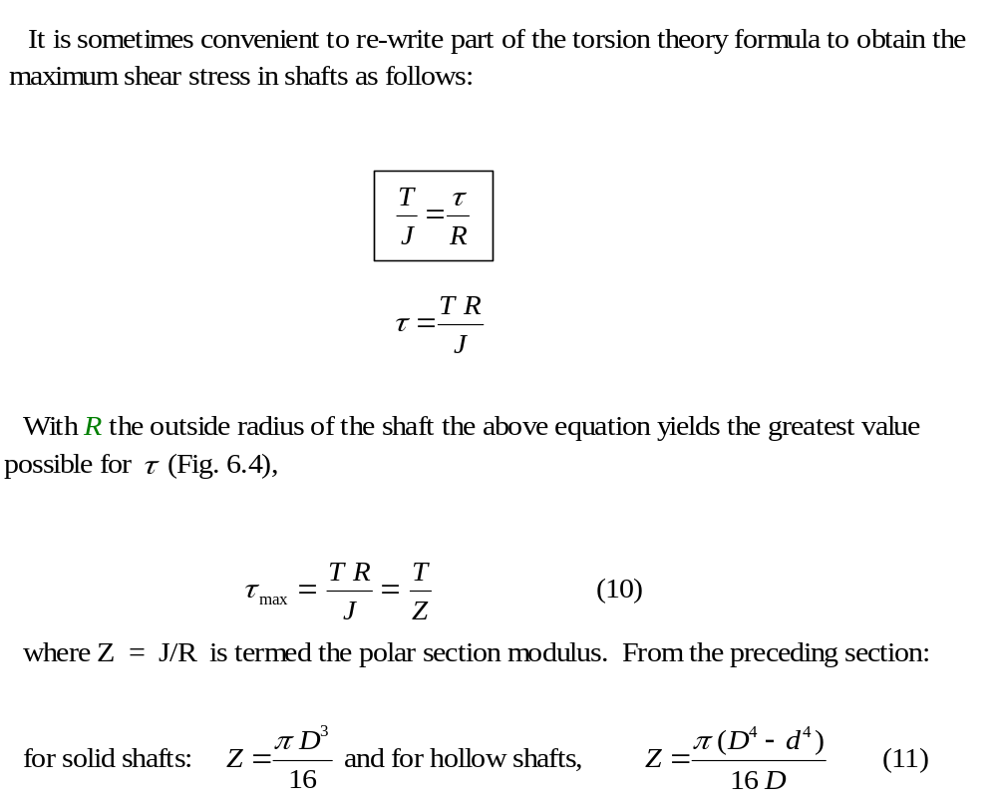
8.4 Section Modulus

Slide 15
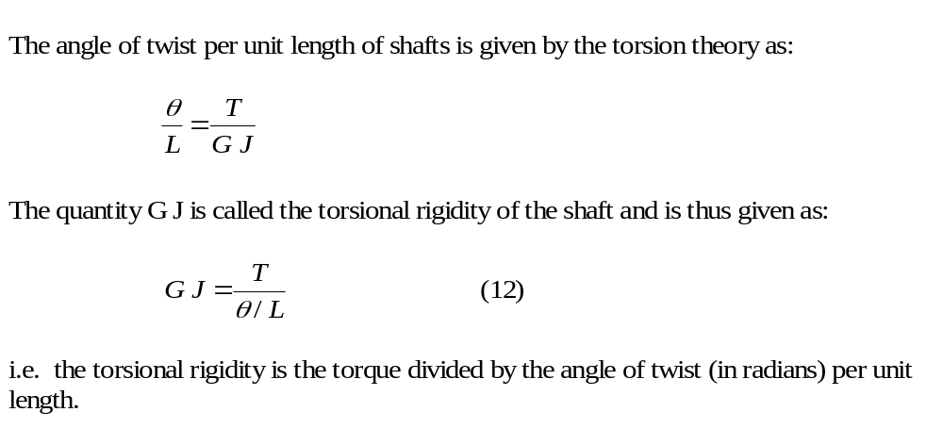
6.5 Torsional Rigidity

Slide 16
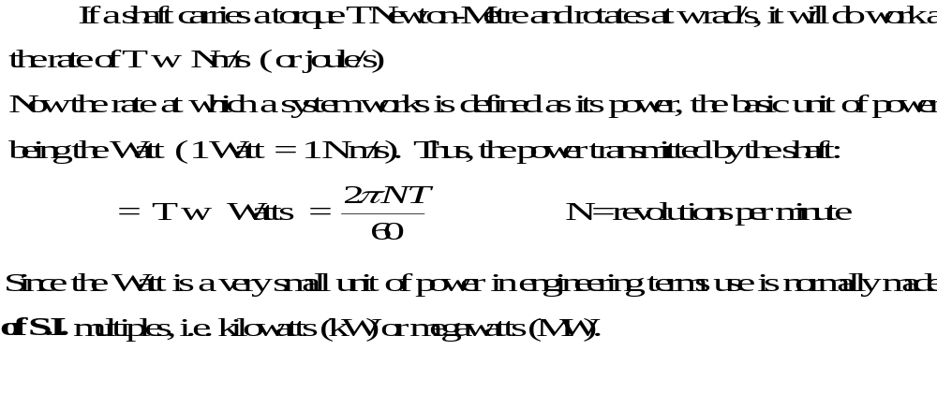
Power Transmitted by Shafts

Slide 17
Combined Stress Systems-Combined Bending and Torsion
In most practical transmission situations shafts which carry torque are also subjected to bending, if only by virtue of the self-weight of the gears they carry. Many other practical applications occur where bending and torsion arise simultaneously so that this type of loading represents one of the major sources of complex stress situations.

Slide 18
Combined Stress Systems Contd.
In the case of shafts, bending gives rise to tensile stress on one surface and compressive stress on the opposite surface whilst torsion gives rise to pure shear throughout the shaft.
An element on the tensile surface will thus be subjected to the stress system indicated in Fig. 6.5 and equation or the Mohr circle procedure derived in Chapter 4 can be used to obtain the principal stresses present.

Slide 19
Combined Bending and Torsion-Equivalent Bending Moment
For shafts subjected to the simultaneous application of a bending
moment M and torque T the principal stresses set up in the shaft can be
shown to be equal to those produced by an equivalent bending moment,
of a certain value M_{e} acting alone.

Slide 20
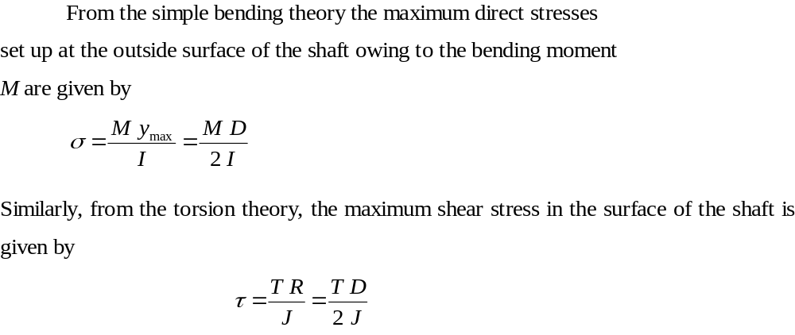
Combined Bending and Torsion-Equivalent Bending Moment Contd.

Slide 21
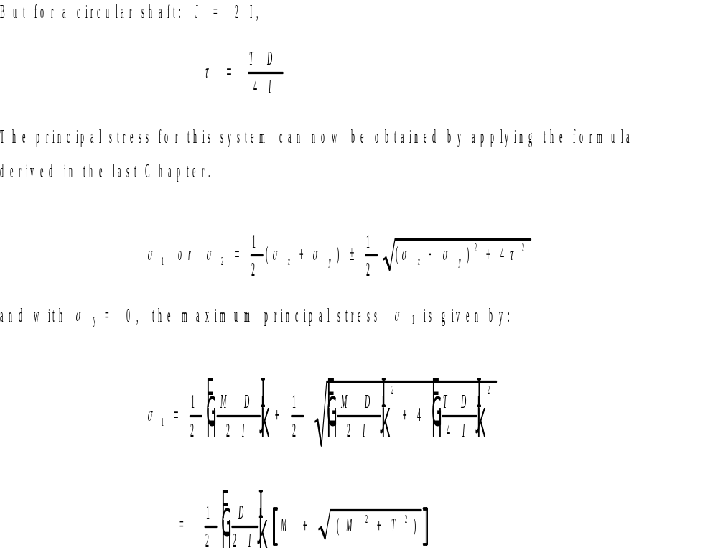
Combined Bending and Torsion-Equivalent Bending Moment Contd.

Slide 22
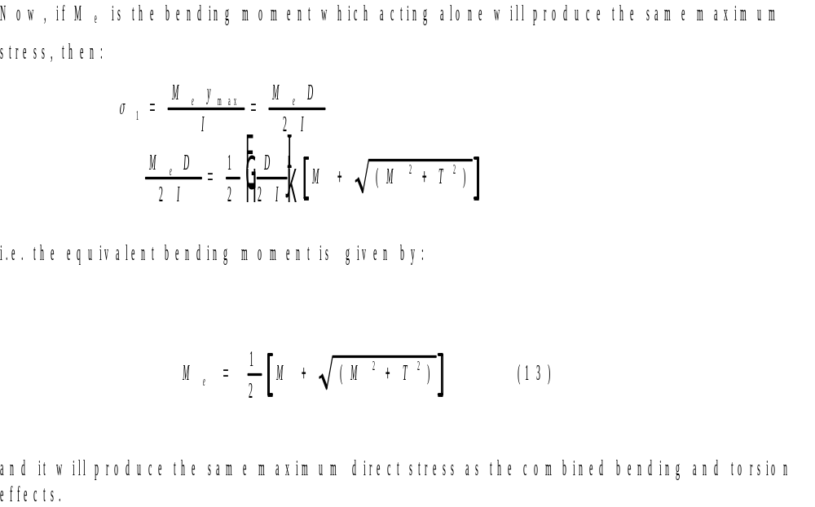
Combined Bending and Torsion-Equivalent Bending Moment Concluded

Slide 23
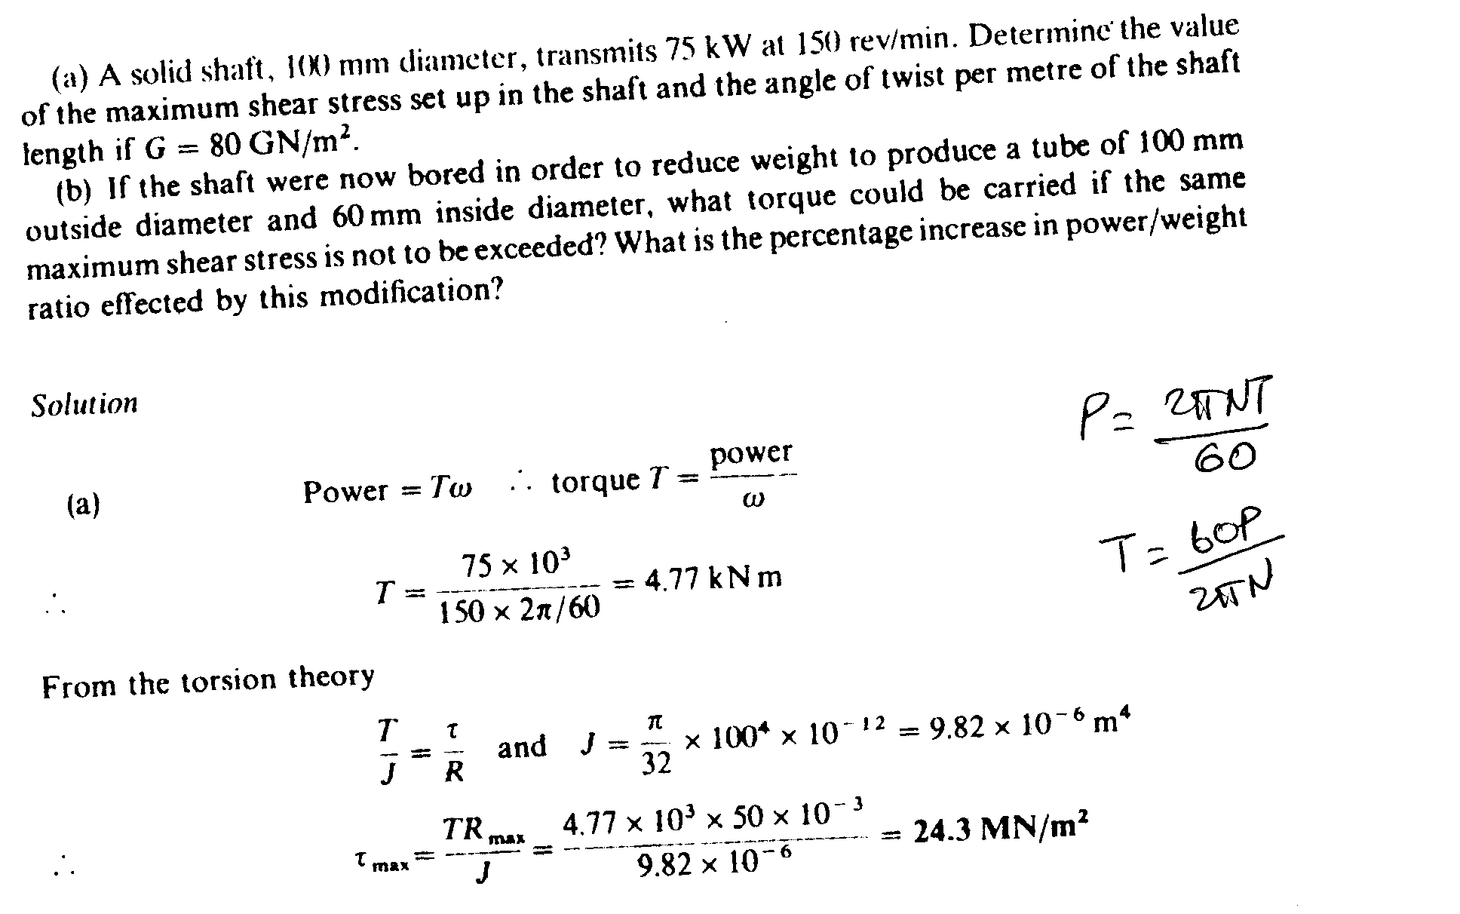

Slide 24
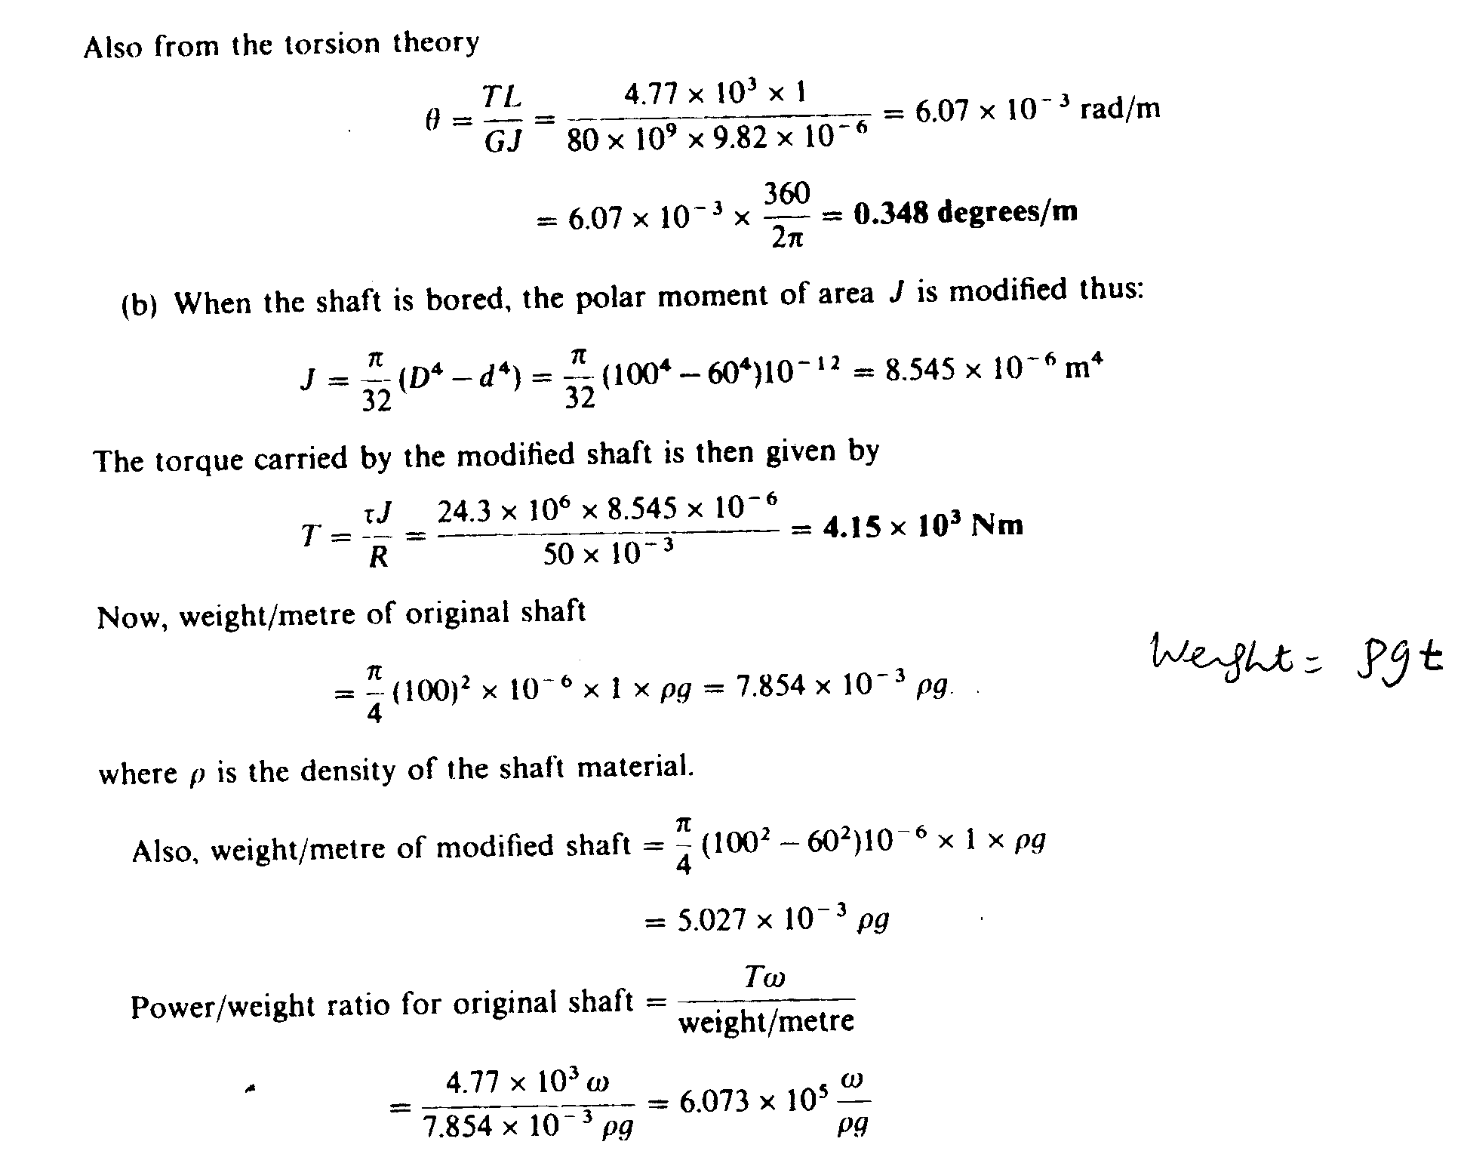

Slide 25
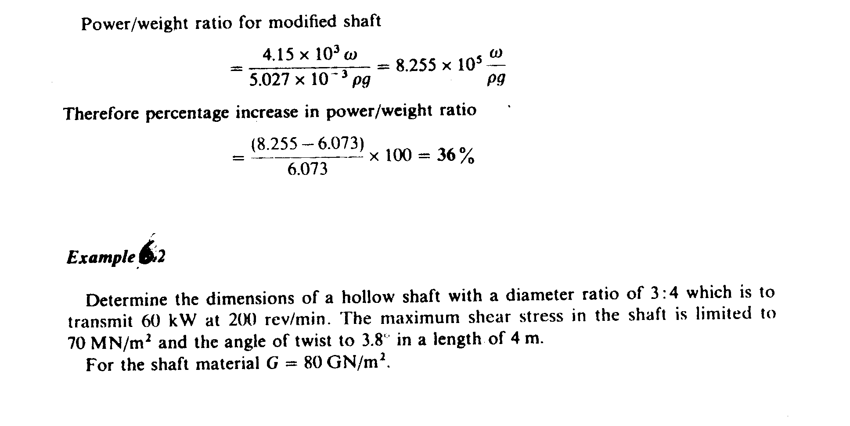

Slide 26
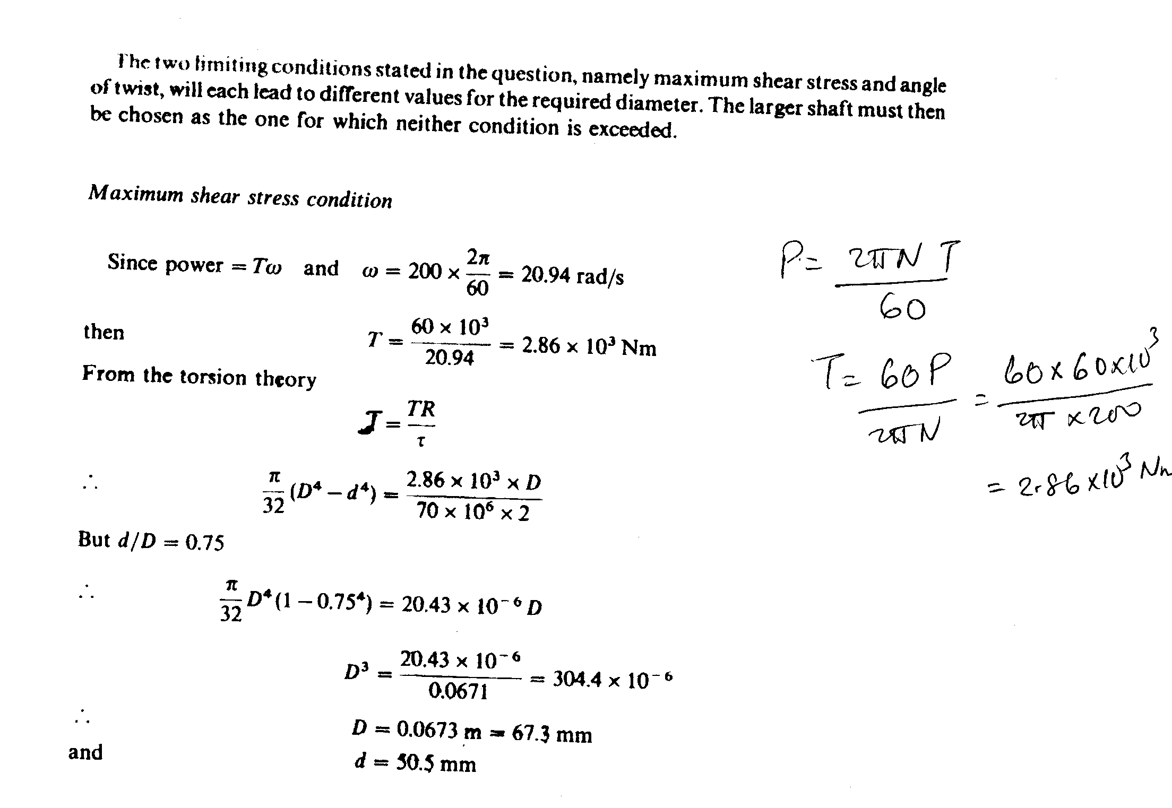

Slide 27
